Slide 1


Introduction to Bash Shell Scripting
Fondren Library
Digital Scholarship Services

Slide 2
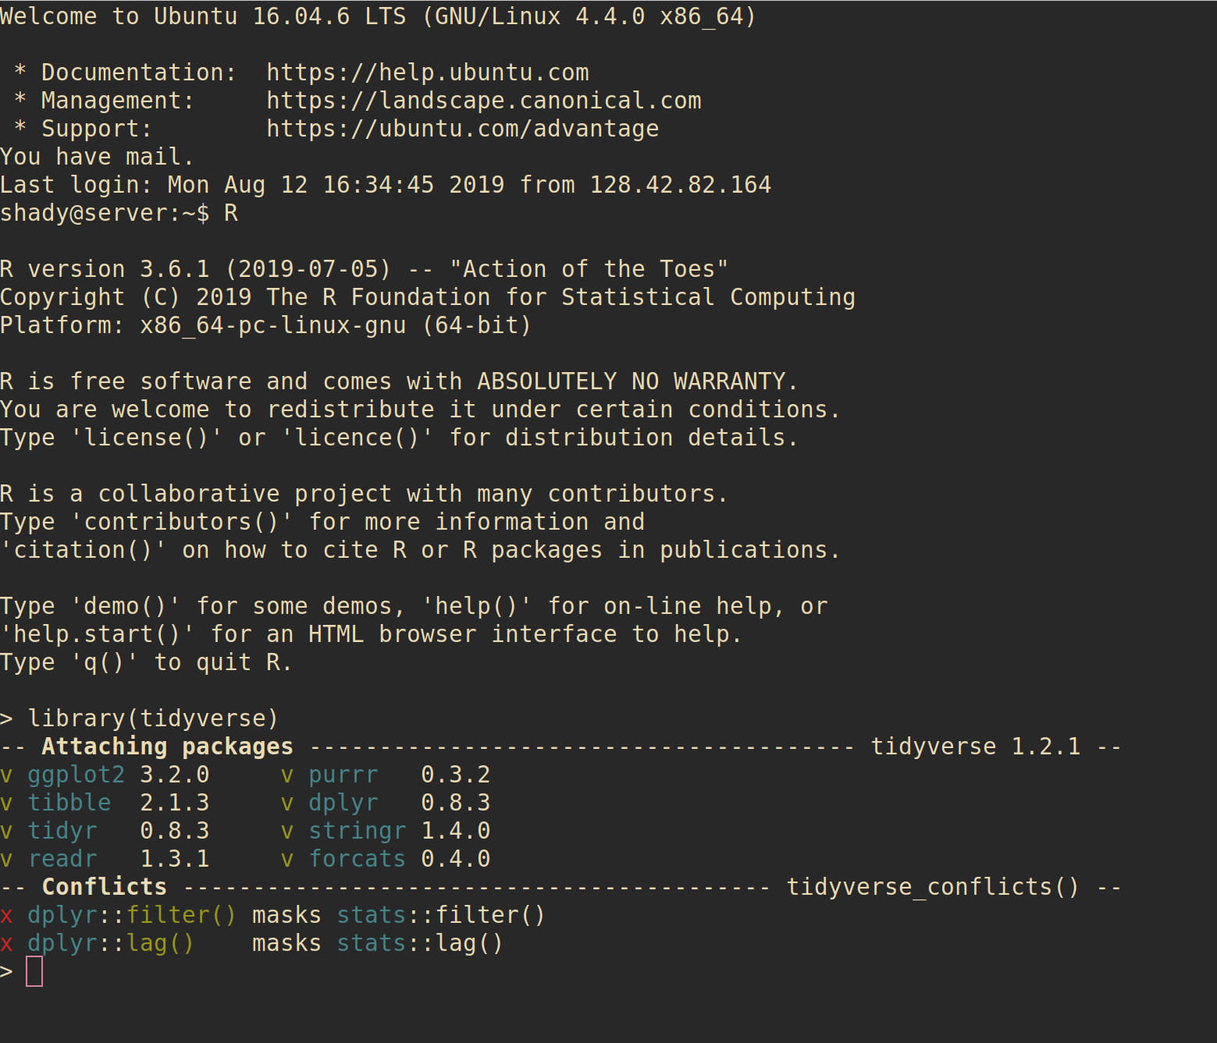
WHAT IS A SHELL?
Very simple and direct interface to an operating system
Allows easy execution of programs and file operations
Highly configurable without needing to sort through massive menus
Fast and lightweight

Slide 3
WHAT IS BASH?
Bourne-Again Shell
Play on words: Stephen Bourne wrote the initial Unix shell
Improved on Bourne shell (sh)
More features, better builtins
Completely free and open-source for all platforms, licensed under the GNU public license

Slide 4
HOW DO I GET BASH?
On Unix-based platforms (Mac OS, Linux, etc) it will almost always be installed by default
Windows (the only major non-Unix-based OS):
Install Ubuntu for Windows
or
Install minGW (minimalist GNU for Windows)
Make sure to select the msys developer kit!

Slide 5
WHEN DO I USE BASH?
Versus Scripting Languages (e.g. Perl, Python, Ruby, Lua)
Bash allows simpler access to commands with extensive shell-specific or installation-specific features, often unsupported by scripting languages
Scripting languages are usually easier to program in but don’t interface seamlessly with the OS
Versus a Visual Environment
Often with remote servers, you have to use a terminal
Visual environments are great for quickly looking through file structures
Shell environments are great if you want to run any slightly advanced query (find operations, etc) and for programming

Slide 6
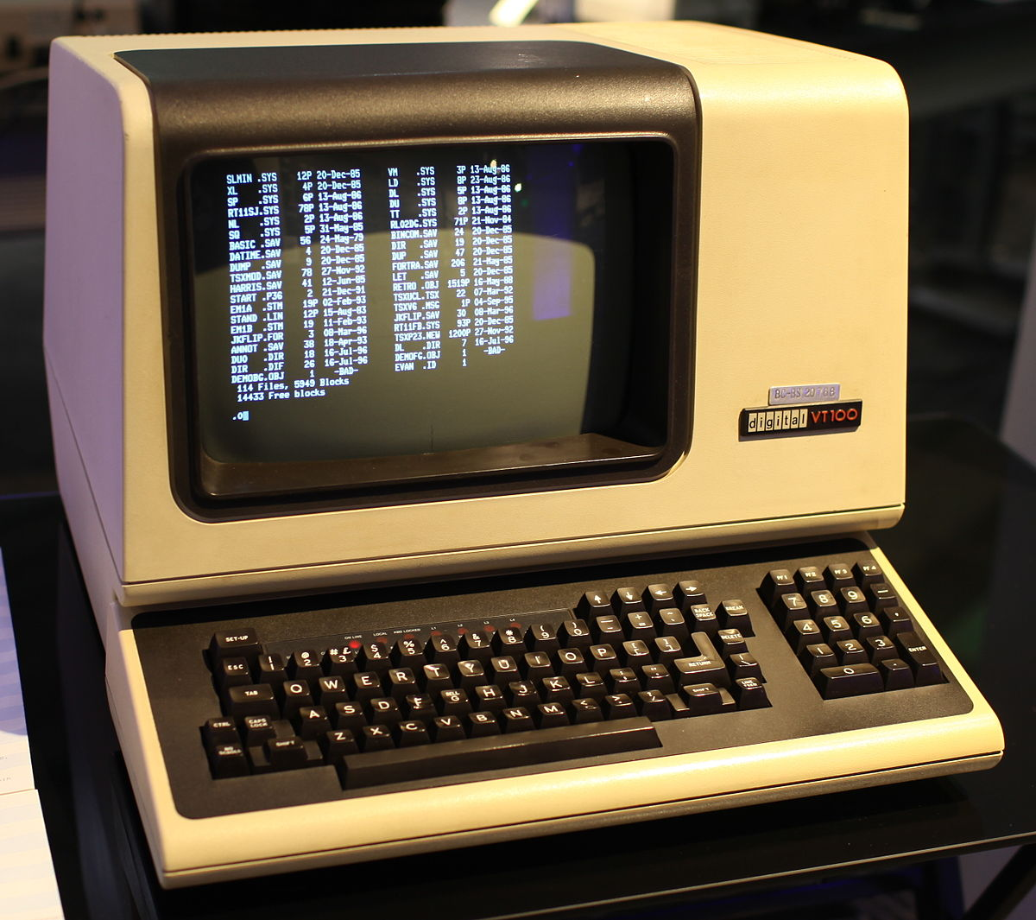
A LITTLE HISTORY
Before the advent of Microsoft Windows (1981) and Mac OS (1984) and their desktop environments, terminals were the only option!
Unix was the most used, developed by Bell Labs at AT&T
Unix adapted by Linus Torvalds into Linux, and enjoyed Free Software Movement support

Slide 7
SHELL BASICS
A quick walkthrough of the environment

Slide 8
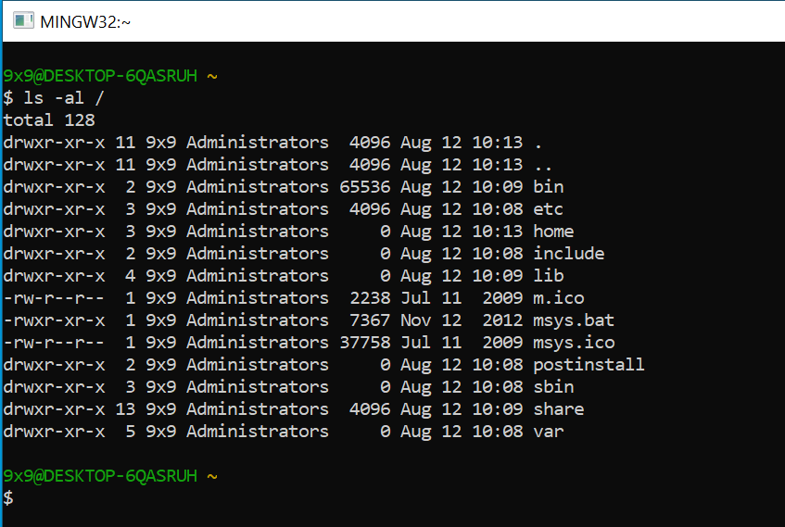
ANATOMY OF A SHELL
Prompt: what you see when you open the shell or finish a command
Waits for you to enter something
USER@COMPUTER (Directory)
$ (type commands here)
completely configurable, though
Command
Output

Slide 9
COMMANDS
First: an executable program (or shell builtin)
Anything from word.exe to simply listing the directory
Any number of arguments
Filenames, command line switches
example: ls –al Documents/
ls is a program that lists the current directory
-al are two separate arguments that show hidden files and permissions
Documents/ is a folder in the current directory we want the get the contents of
Use --help!

Slide 10
ENVIRONMENT
Several environment variables
PWD (print working directory)
PATH (where to look for executable files – usually not your current directory!)
Many more (if you’re curious, type in env!)
This is how we can keep track of our state
Note that on Windows (more accurately NTFS/FAT file systems) case does not matter (File.txt is the same as filE.tXt), but on Linux (ext4) case matters

Slide 11
FILES
Special file shortcuts in bash
. -> This directory
.. -> Parent directory
~ -> User’s home directory
/ -> System root
Just type a few characters of the file then press tab to autocomplete!
Permissions: read, write, and execute
Any file can be executed!

Slide 12
CONFIGURATION
Making your shell look and act its best!

Slide 13
COLORS
Modern shells have support for colors
Great for distinguishing between file types (directory versus program versus document)

Slide 14
FONTS
Technically, a feature of your terminal emulator, not the terminal itself

Slide 15
PROMPTS
Configure the colors and information displayed on your prompt

Slide 16
ADVANCED FEATURES
Interprocess communication, signals, jobs, and more

Slide 17
INPUT AND OUTPUT
3 separate input/output streams
Standard Output
Standard Input
Standard Error
Redirection

Slide 18
PIPES
Sending output to a different program

Slide 19
VARIABLES
Can name pieces of information and refer to them laters

Slide 20
IF STATEMENTS
Conditionals:

Slide 21
FOR LOOPS
Good for ranges of values (i.e. a-z, 0-9)
Or, for lists of values (“cat”, “dog”, “frog”)

Slide 22
WHILE LOOPS
Do something over and over, until the condition is false

Slide 23
JOBS
Multiple processes can be running in the shell at the same time
Start a job in the background by ending the line with &
Switch it back to foreground with fg
Great for long running processes

Slide 24
SIGNALS
Ctrl+D
Ctrl+C
Ctrl+Z

Slide 25
ALIASES
Handy shortcuts for long commands with lots of arguments

Slide 26
SPECIAL FILES
.bashrc
Run every time you start bash
Great for configuring global settings
.bash_profile
.bash_history
Re-run previous commands with arrow keys up/down

Slide 27
USEFUL PROGRAMS
A quick overview of our tools

Slide 28
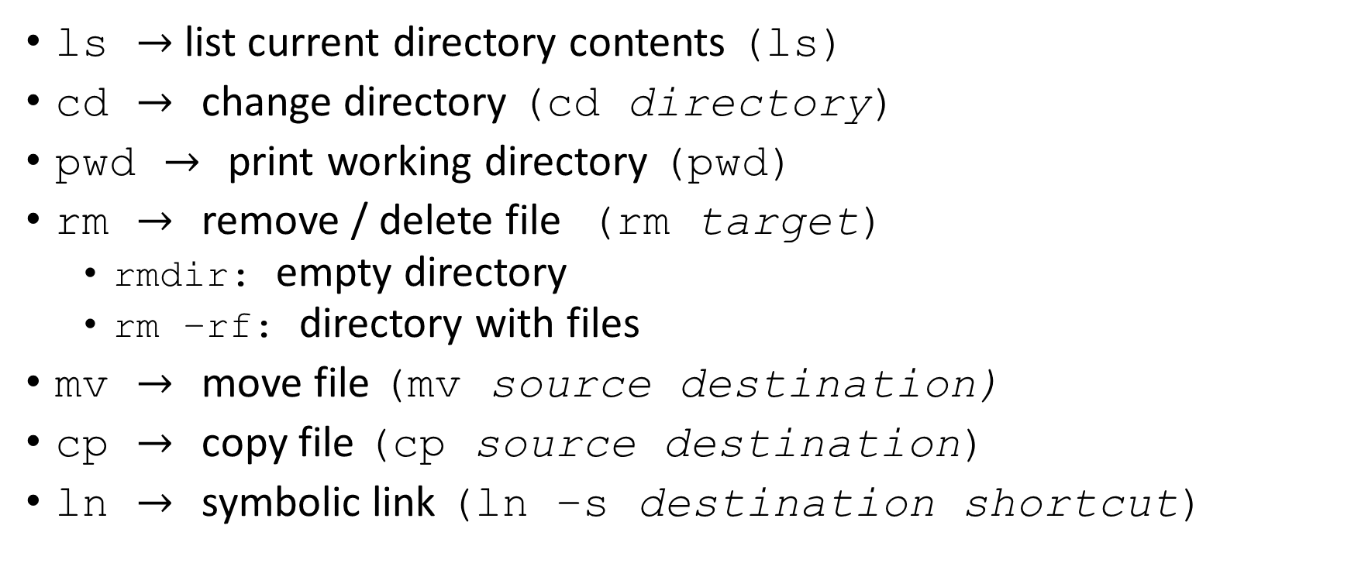
FILES AND DIRECTORIES
ls $→$list current directory contents (ls)
cd $→$ change directory (cd directory)
pwd $→$ print working directory (pwd)
rm $→$ remove / delete file (rm target)
rmdir: empty directory
rm –rf: directory with files
mv $→$ move file (mv source destination)
cp $→$ copy file (cp source destination)
ln $→$ symbolic link (ln –s destination shortcut)

Slide 29

OPERATIONS
Find $→$
Grep $→$
Parallel $→$
Xargs $→$
Sed $→$
Bc $→$
Wc $→$

Slide 30
AUTOMATING TASKS
A sampling of common use cases

Slide 31
AUTOMATION
Perhaps the best feature of bash and shell environments – easy automation!
Want to run a command once a day to clean up cached files? Easy!
Want to simplify a complex process so you can do it all by typing one word? Easy!

Slide 32
SCHEDULING WITH CRON
Crontab: has information for scheduling
Use https://crontab.guru to help with syntax
Example:
30 4 * * MON rm –rf /tmp/* means delete all temporary files at 4:30 AM every Monday

Slide 33
BASH FUNCTIONS
Great for writing quick functions that don’t quite fit into alias form

Slide 34
ACKNOWLEDGMENTS
The Bash Logo is licensed for free use under the Copyleft license.
The bash screenshot on Slide 2 is R and Bash running under a Remmina connection.
The picture on Slide 6 is licensed under Creative Commons Attribution-ShareAlike 4.0 International, created by Gorthmog

